Slide 1
Automatización y control de sistemas de distribución
Especialización Sistemas de Distribución de Energía Eléctrica
26608
Septiembre de 2014

Slide 2
Señales de alarma..
(*) Propaganda Cursos Capacitación en transformadores

Slide 3
News: Welcome to the Digital Utility. T&D World Jan. 2007,www.t&dworld.com
Intelligent Distribution: many initiatives
90% of the outages occur at distribution
19% of the power go to ground due to unbalances in typical US feeders

Slide 4
Modulo 1: SCADA
Sandra M Téllez G
smtellezg@unal.edu.co
Automatización y control de sistemas de distribución

Slide 5
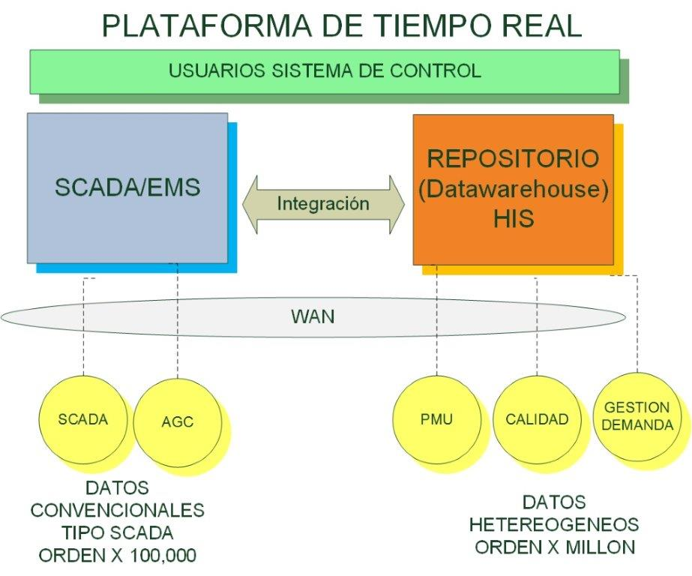
SCADA Ampliado

Slide 6
SCADA Functionality
Data Acquisition
Data Exchange
Supervisory Control
Tagging
Data Processing
Historical Information System
Post Mortem Review
Network Coloring
Switching Management
Time Synchronization – NTP
Configuration Management - SNMP

Slide 7
1. Data Acquisition
Remote Terminal Units
Local RTU Input/Output
Time and Frequency Standard Subsystem
Weather Stations
Intelligent Electronic Devices

Slide 8
2. Data Exchange
Data Links with:
National Load Dispatch Center
Other Regional Load Dispatch Center
Distribution Control Center
Plant/Substation Automation System
Control Center PC LAN
Corporate Information Systems

Slide 9
3. Supervisory Control
Control Commands
Two-State Device Control
Incremental Device Control
Automatic Supervisory Control
Control Permissive
Control Completion Check

Slide 10
4. Tagging
Device Tagging
Tagging User Interface
Tagging Levels
Tag Lists
Tag Placement & Removal Recording

Slide 11
5. Data Processing
Scanned Analog Data
Data Conversion
Limit Checking
Rate-Of-Change Limit Checking
A/D Accuracy Monitoring
Dynamics Limits
Scanned Status Data
Breaker-With-Reclose Status Handling
Slow Moving Device Status Handling
Status Indication Processing
Sequence-Of-Events Processing
Scanned Accumulator Data

Slide 12
Status Processing

Slide 13
5. Data Processing (Cont’d)
Calculated Data
Calculated Analog Data
Calculated Status Data
Line & Transformer Loss Calculations
Non-Telemetered Data
Data Quality
Switching Orders
Real-Time Planned Outage

Slide 14
Alarm/Event Processing
Knowledge-Based Alarm Suppression
Direct Linkages (can use pseudo status points)
Indirect Linkages
Area of Responsibility
Use for each alarm window and each printer
Use to route alarms to proper windows/dispatchers and/or printers
Priority
Each point has a priority level
Every alarm window has an assignable alarm priority level
By increasing the alarm priority level of an alarm window, lower priority alarms are suppressed from the alarm window
Timed Alarm Suppression
Each data point may be assigned a transient filter
Used to suppress an alarm until it has remained in the alarm state for the length of time specified with the transient filter

Slide 15
Alarm/Event Processing (cont’d)
Momentary Alarm Change Detect
Tracks rapid multiple state changes that are recorded by the RTU
Operations counter to track device operations for maintenance reporting
Alarm Acknowledge / Delete
Separate acknowledge and delete actions
Alarm automatically deleted upon acknowledgment if alarm has returned to normal
On acknowledgment alarm will be deleted from alarm list
Alarm is deleted after a specified time delay following acknowledgment of alarm

Slide 16
Alarm/Event Processing (cont’d)
Alarm Acknowledge / Delete
Separate acknowledge and delete actions
Alarm automatically deleted upon acknowledgment if alarm has returned to normal
On acknowledgment alarm will be deleted from alarm list
Alarm is deleted after a specified time delay following acknowledgment of alarm
Historical Events File
All events, including alarms, stored in a daily file
Can be sorted and used to create reports

Slide 17
Alarm Processing

Slide 18
Alarm Processing

Slide 19
Alarm Processing

Slide 20
Classification of events

Slide 21
6. Historical Information System
HIS Data Collection
HIS Data Calculation
HIS Data Archiving
Historical Database Generation & Maintenance
HIS Data Quality Codes
HIS Audit Travel Event Report
Daylight Saving Time
HIS Server Requirements
HIS Client Capabilities
SCADA/EMS Function Access
Local User HIS Client Capabilities

Slide 22
7. Post Mortem Review: now also replay function

Slide 23
8. Network Coloring
Need to present the following conditions:
Color ID for voltage level, distribution circuits, etc.
Energized vs. non-energized system portions
Grounded elements
Two forms:
SCADA model the power system elements and their connection: preferred form
Use of topology model from load flow: need topology application not part of SCADA

Slide 24
9. Switching management
Need of a support to operators to implement sequences of operations in a consistent form
Operations could be:
Automatic: SCADA
Manual: with crew interventions
Sequence recording: like a Macro of Excel
Disconnection: sequence in the original form
Reconnection: sequence in reverse order
Automatic orders performed with one command
Step by step possible implementation
Waiting time until manual intervention
Simulation mode is possible
Storage of multiple sequences

Slide 25
10. Time synchronization
Almost all devices have an internal clock: Servers, consoles, PCs, IEDs…
Time synchronization is required: 1ms time resolution for Sequence of events recording - SOE
Possibilities:
Protocol implemented time synchronization using protocol messages: Local control center master time clock, used before in most control systems. Case of clock failure one server clock used as master
NTP: Network Time Protocol used for Windows platforms
Local GPS used as time reference with a IRIG-B command

Slide 26
11. Configuration Management
Need to monitor the entire control system including:
Master station devices, field equipment, substation equipment, communication equipment, etc.
Need the report of each devices about operating conditions
Use of a protocol to report data to the configuration management site: SNMP – Simple Network Management Protocol
Application: detect device failures, communication failures, etc.

Slide 27
User Interface
Types
X-Terminal
Workstation
PC Emulating X-Terminal
Resolution
Character Graphics (Remote Consoles for Limited Bandwidth Applications)
Full Graphics (1280 x 1024 pixels)

Slide 28
User Interface (cont’d)
Monitors
19", 20", 21"
Workstations with One, Two, Three or Four Monitors or Heads
Consoles to Main Processors
Single or Dual LAN Connection
Typically IEEE 802.3 / Ethernet
Possibly 100 MBit/Sec FDDI

Slide 29
User Interface (cont’d)
Features
Pan
Zoom
Layers
Levels of Declutter
Import of Schematics, Maps and CAD-Based Drawings
Projection Systems/Dynamic Mapboards

Slide 30
Keyboard

Slide 31
Mouse

Slide 32
Displays

Slide 33
System Security

Slide 34
Authorities

Slide 35
Operator information

Slide 36
Basic One-line displays

Slide 37
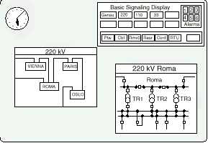
Drag&Drop

Slide 38
Panning

Slide 39
Zooming

Slide 40
Decluttering

Slide 41
System Configuration

Slide 42
Navigator

Slide 43
Alarm Lists
04.11 03:32:53 Vienna 220 Rome Iso Eth close MU U1
04.11 03:33:01 Vienna 220 Rome Iso Eth open MU U1
04.11 03:36:57 Vienna 220 Moscow Iso Eth CtrlInhbt set MU U1
04.11 04:12:46 Vienna 220 Rome Iso Eth RevOperat reset U1
04.11 04:12:47 Vienna 220 Rome Iso Eth open U1
04.11 04:13:55 Vienna 220 PermtWork reset U1
04.11 04:14:14 Vienna 220 Moscow Iso Eth CtrlInhbt reset U1
04.11 04:15:49 Vienna 220 Moscow CB CtrlInhbt set U1
04.11 04:16:11 Vienna 220 Moscow CB RevOperat set U1

Slide 44
Use of Colors: Alarms

Slide 45
Help functions

Slide 46
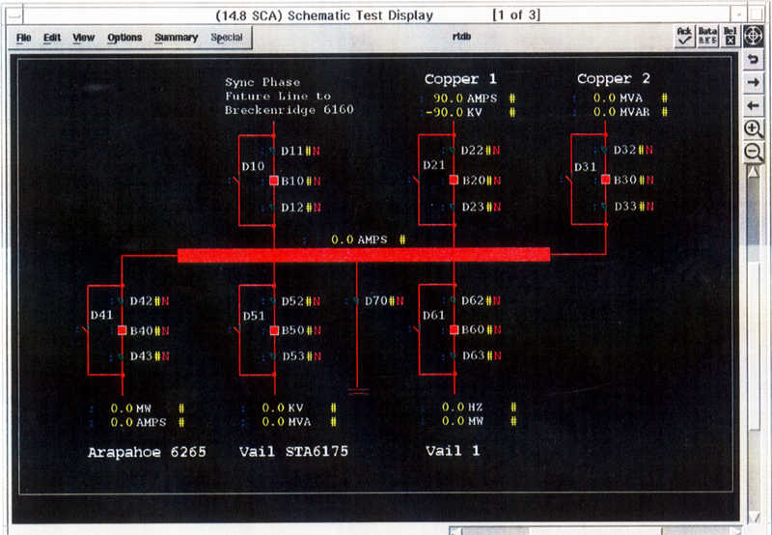
One Line Display

Slide 47
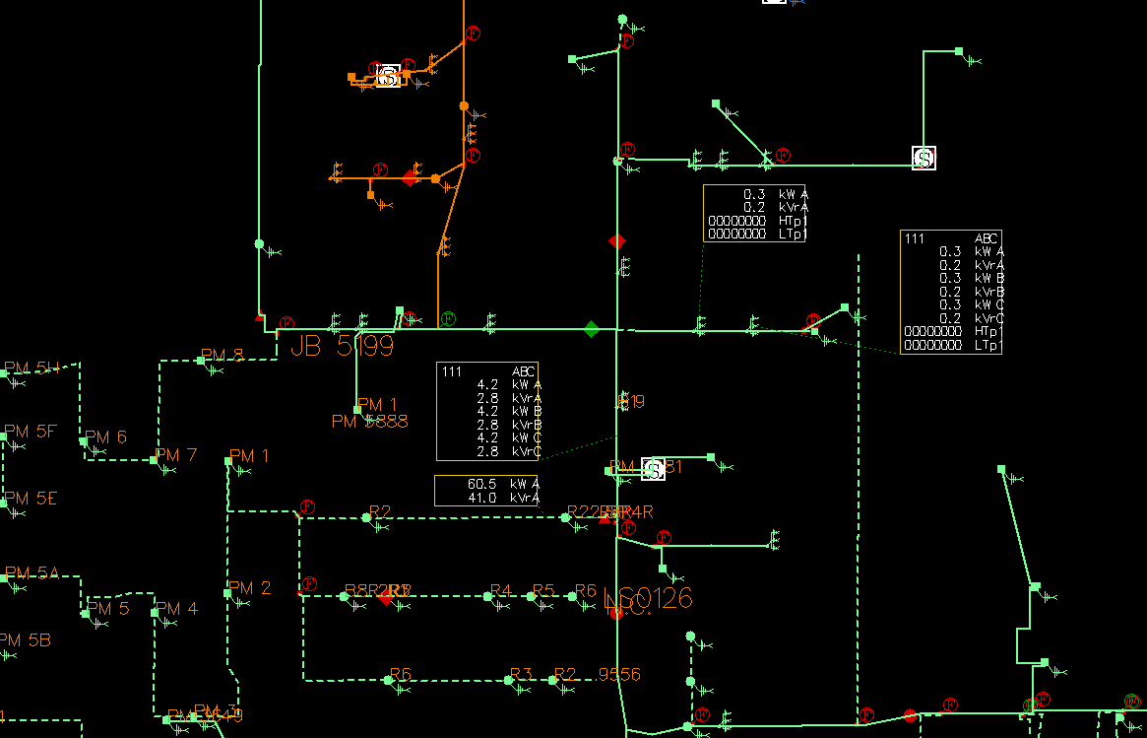
Feeder Map Display

Slide 48
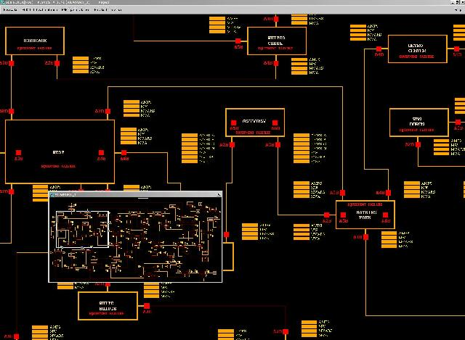
World Coordinate Display: Schematic Diagram

Slide 49
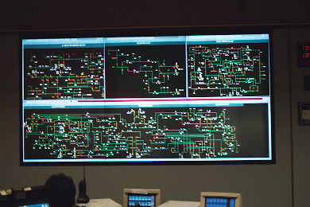
Mapboard/Projection Screens

Slide 50
Gracias
Especialización Sistemas de Distribución de Energía Eléctrica
Julio de 2016

